Slide 1
Online Model Learning and Control from Streaming Data using Gaussian Processes for Robot Teleoperation
Presentation by Brian Wilcox
ARClab

Slide 2
Overview
Motivation
My Research Goal
Methods
My Approach
Implementation
Results
Challenges
Plans Ahead

Slide 3
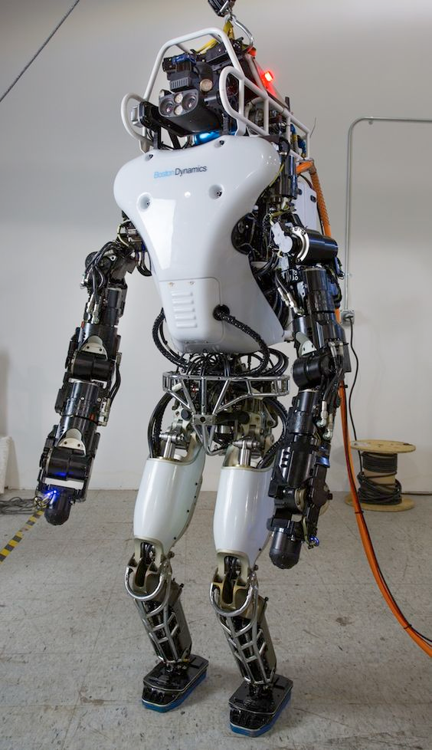
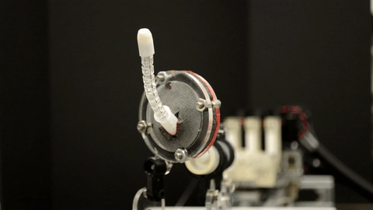

Motivation: Learning to Manipulate
Many complex robotic systems have:
Inaccurate or unknown system models
Unknown environment dynamics
Non-stationary behavior
Through machine learning, we can learn a model of very complex systems, however, there remain many challenges such as:
Large Training Time
Data Availability
Deterministic Models
Appropriate model selection

Slide 4
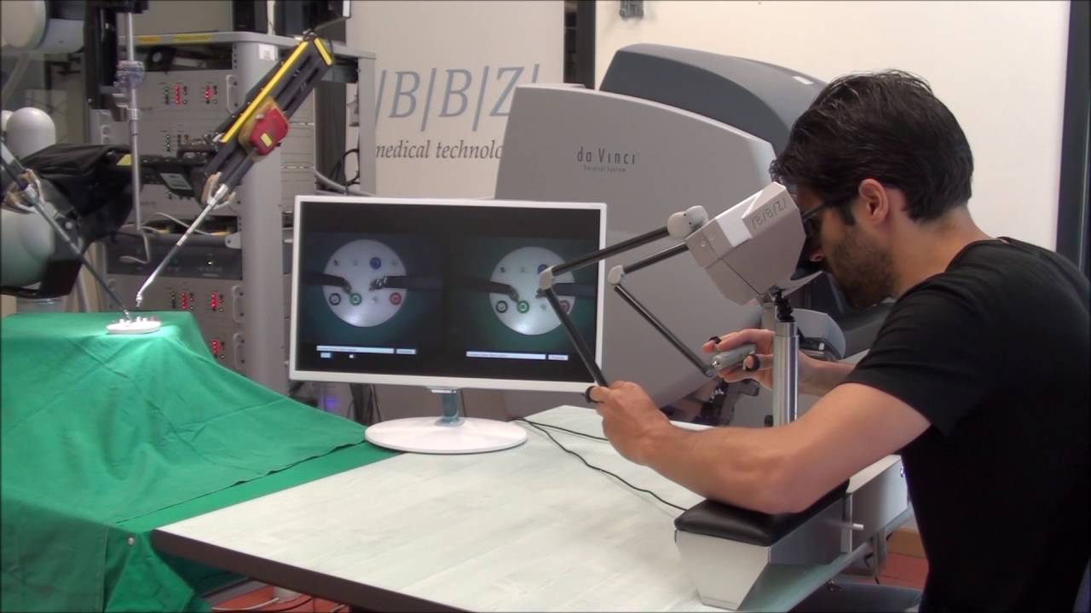
Motivation: Teleoperation
In teleoperation tasks, both sensor readings and motor commands come in streams of data
For a data-driven controller, the robot model (mapping from state to actuator) should be learned and adapt to these streams of data, while also making accurate predictions about the desired actuator inputs
In a nutshell, need a controller which is:
Robust
Adaptive
Real-Time
Data-efficient

Slide 5
My Research Goal
Aim: Online model-learning and control (inverse kinematics) for a teleoperation task
Plan: Sparse Online Local Gaussian Process Regression (SOLGPR) to infer a mapping of robot sensor states (task space) to joint states and perform a prediction of the teleoperation command for joint control.
Potential Application: Teleoperation of remote robotic catheter for catheter ablation in minimally invasive surgery

Slide 6
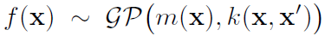
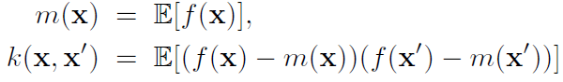
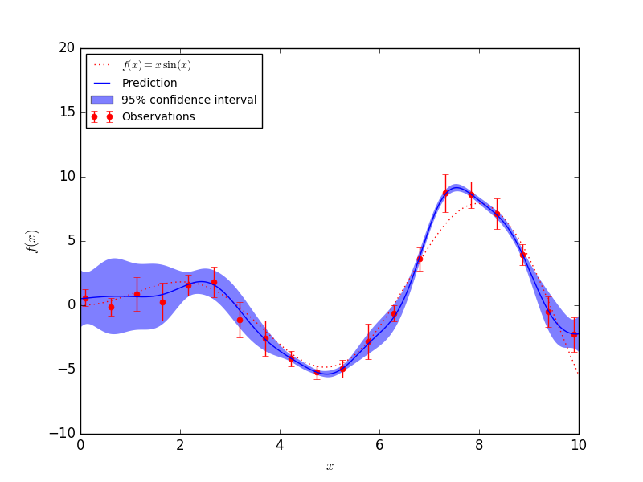
Methods: Gaussian Processes
Gaussian Process is a distribution over functions (Rasmussen & Williams ‘06)
GP is characterized by a mean function, m, and covariance function, k
In regression, we want to infer the function output for test inputs, f*
We learn by optimizing the hyperparameters of the covariance function

Slide 7
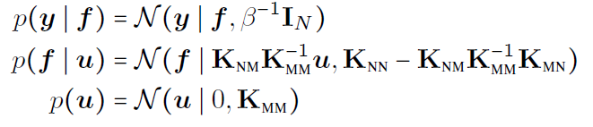
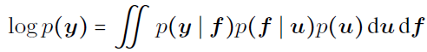
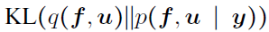
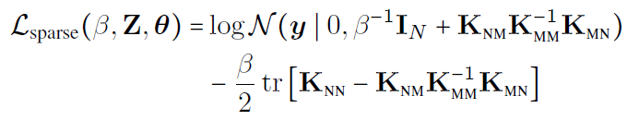
Methods: Sparse Gaussian Processes (via VI)
Support Points:identify/induce a small set of support points , M << N, that can approximate the kernel matrix, K, thereby reducing the computational complexity
Variational Inference for GP: First introduced in (Titsias ‘09)
Approach: infer the induced support points (and kernel hyperparameters) via VI
→

Slide 8
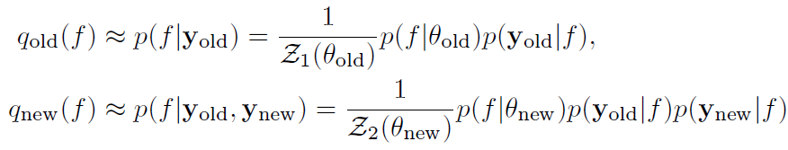
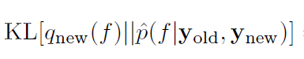
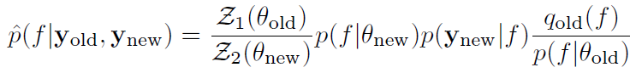
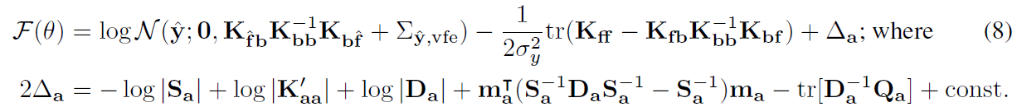
Methods: (Streaming) Sparse Gaussian Processes
Goal: Apply VI in the sequential streaming setting (i.e. with incremental updates)
Approach: Update previous approximation to true posterior to form new one
Reconstruct KL-divergence:
Get variational free energy / lower bound:

Slide 9
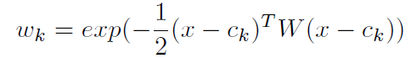
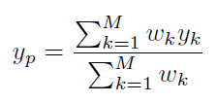
Methods: Local Gaussian Processes
In GP, can find local models of our dataset, each with partitioned local points (Nguyen-Tuong et al. ‘08)
New points are partitioned into local models according to a distance metric between a query point and a center
A new local model is added when w_{k} < w_{gen} and its covariance matrix is updated
For prediction, uses a modified* weighted prediction
*the choice of W is determined by optimizing a subsampled full GP

Slide 10
My Approach: Sparse Online Local Gaussian Processes
Jitter robot joints for N_{jit} points
Initialize:
Partition jittered points
Train initial model M₀ with up to K inducing points
Initialize a sparse “drifting” GP model, M_{drift} = M₀
Receive test input, x_{test}
Predict output, y_{pred}
Control : y_{pred} → x_{exp}
Train M_{driftt} ← (x_{exp}, y_{pred})
Partition new experience (x_{exp}, y_{pred}) into local models M_{k}
Train sparse online local models, M_{k}
Repeat 3-9
Test Input
y
x
Local GP
Prediction
Robot
Drift GP

Slide 11
My Approach: Sparse Online Local Gaussian Processes
Notable Modifications:
Sparse “Drifting” GP Model
Model hyperparameters and support set, Z, are updated online via streaming GP method
Replace a current support point(s) with the new training point(s) before optimization
Use trained kernel (RBF) lengthscales for partitioning/prediction
Local “Streaming” Sparse GP Models
No need to store partitioned data points for each model
support set Z updated online via streaming GP method
Hyperparameters set to “drifting” GP hyperparameters
Newly created models are seeded with “drifting” GP
Weighted Confidence Circular Prediction
Combining local prediction variance into weighting {ex. wv = w*np.exp(-10*dw)/var) }
Biasing weights by distance between local model predictions and previous experience
Weighted circular mean used for angular predictions
*Can also increment/decrement number of inducing points on the fly

Slide 12
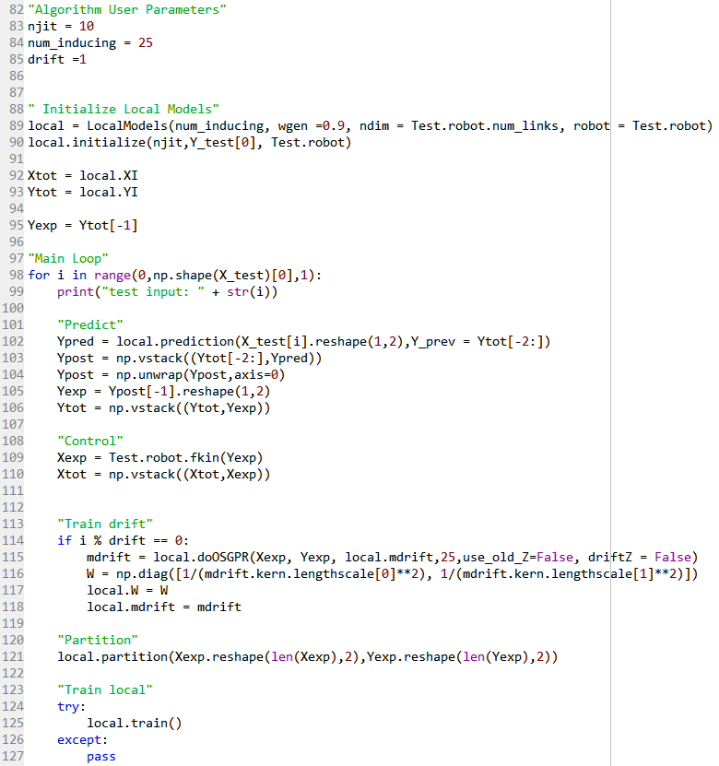
Implementation: Algorithm
Algorithm implemented in Python
Leverages GPy library
Currently run with offline trajectory
Created a class object, LocalModels, to maintain all attributes and functions for the algorithm

Slide 13
Implementation: Testing (Simulation)
As of now, testing is done via my own custom Python class objects:
RobotModel: nLink2D
Includes forward kinematics, plot utilities, and (optionally) inverse kinematics
Trajectory: Circle2D, Star2D, Spiral2D, nPoly2D, nRect2D
Creates test trajectories in 2D (for now)
TestData
Container for robot model and trajectory
**“Control” of the robot model is done via forward kinematics given the predicted joint position from algorithm

Slide 14
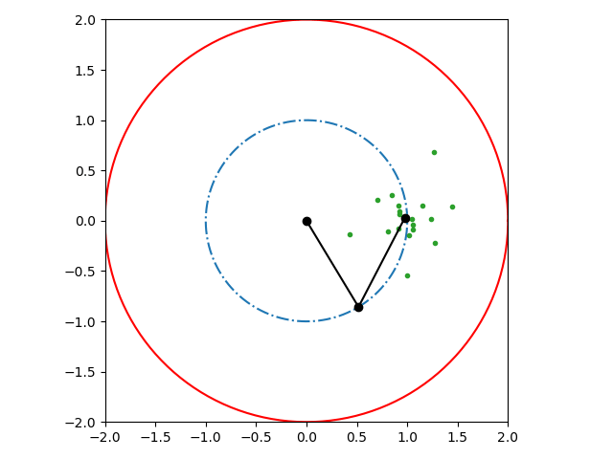
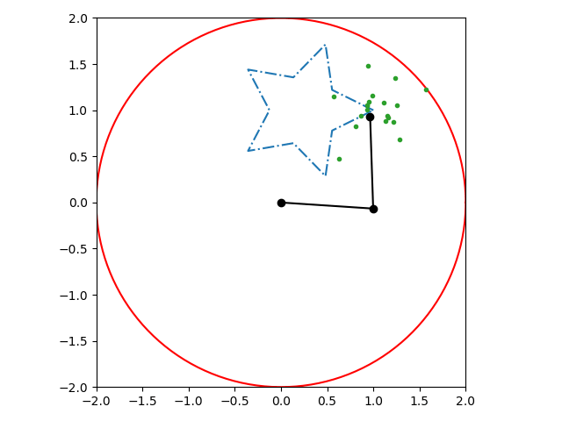
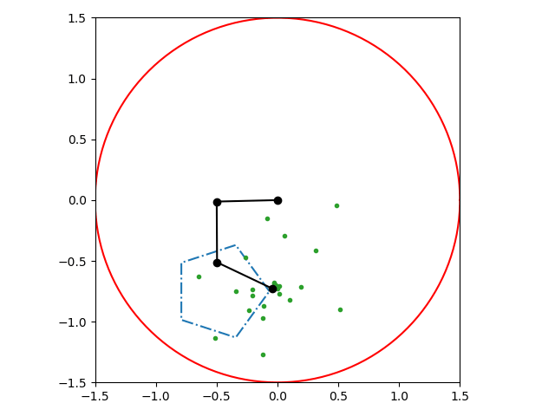
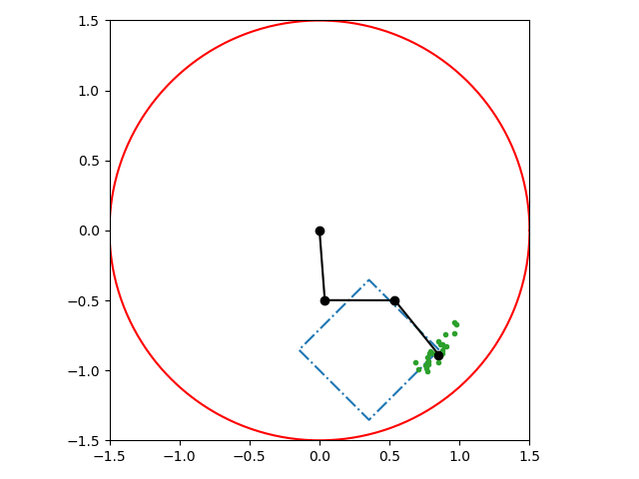
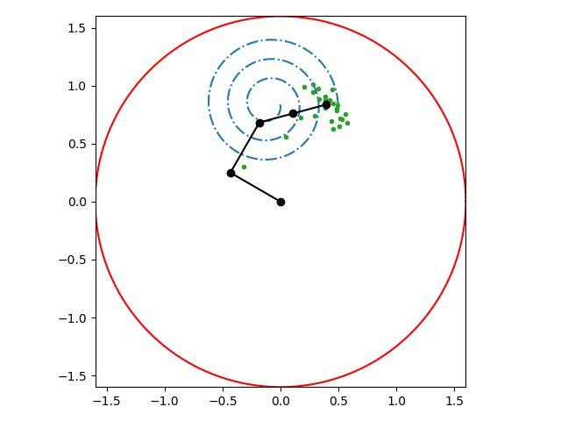
Results
On various trajectories, locations, and number of links

Slide 15
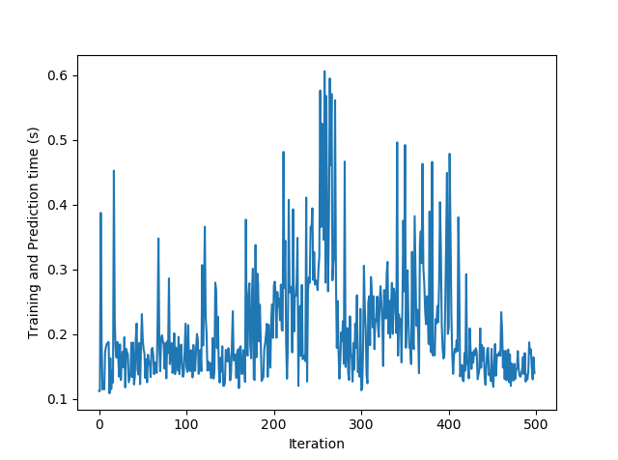
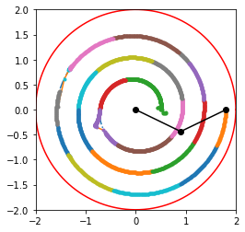
Challenges
Angle wrap around
Partially “resolved” by unwrapping all angle predictions
Discontinuities/Uncertain predictions
Could be solved by jitter
Also (as Professor Yip suggested) by scaled small movements
Teleoperation interactivity
Desire for predictions to be both at pace with operator AND with good performance
pause/delay new teleoperation commands until good/safe prediction is made
Real-time speed
Reduce complexity in any overhead over redundant computations
Limit optimization iterations
Tradeoff model complexity for performance when reasonable

Slide 16
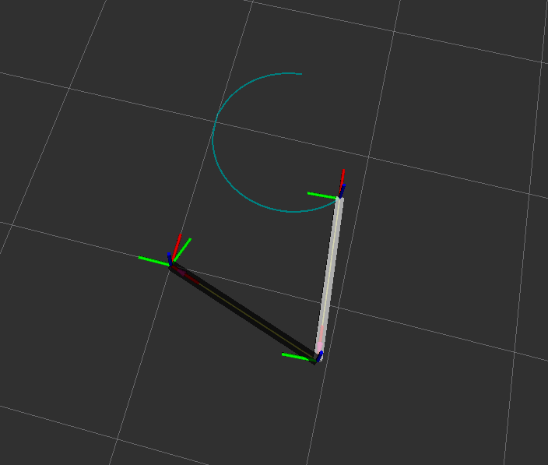

Plans Ahead (or in Progress)
In Progress:
3D Robot Models in URDF format
Transition back to ROS
Simulation on 3D → nDOF manipulator
Ahead:
Teleoperated Inputs (via keyboard or Xbox Controller)
Model Parameter Tuning Strategy
Speed Improvements & Optimizations
Support for real robot sensing/control

